Slide 1


MINOR PROJECT-IV
MINOR PROJECT SECOND REVIEW

Slide 2
Design and development of Advanced Acoustic Metamaterials for tackling tinnitus and Urban Noise mitigations

Slide 3
PRESENTED BY
SHANJAY R K (927621BEC195)
SIVARAMAKRISHNAN M (927621BEC201)
SUBASH P (927621BEC213)
VISHWA S (927621BEC243)
GUIDE BY
Dr.P.JEYAKUMAR(AP/ECE)

Slide 4
SYNOPSIS :
Introduction
Problem Statement
Objectives
Existing System
Proposed System
Conclusion
References

Slide 5
Introduction:
This project aims to pioneer the design and development of advanced acoustic metamaterials.
Offering innovative solutions to mitigate urban noise pollution and alleviate the symptoms of tinnitus, thus fostering healthier and quieter environments.
This project focuses on creating innovative materials to make cities quieter and help people with tinnitus feel better.

Slide 6
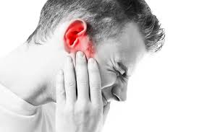
Problem Statement:
Many individuals experience tinnitus, a condition characterized by persistent ringing or buzzing sounds in the ears, which can significantly affect their quality of life.
Urban areas are often plagued by excessive noise pollution
from traffic,construction, and other sources,
leading to stress, sleep disturbances,and
potential health issues for residents.

Slide 7
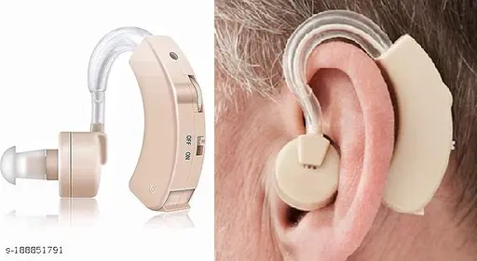
Existing System
Current solutions for tinnitus management primarily focus on symptom masking through the use of white noise generators or hearing aids, which may provide temporary relief but often fail to address the underlying cause or provide long-term benefits.
Existing acoustic metamaterials for noise control typically target specific frequency ranges or are designed for niche applications, lacking versatility and scalability for widespread adoption in addressing both tinnitus and urban noise challenges simultaneously.

Slide 8
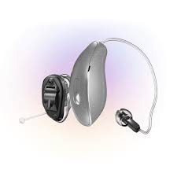
Proposed System
Integration of acoustic metamaterials into hearing aid devices presents a novel approach for personalized urban noise mitigation, offering individuals with tinnitus not only enhanced auditory support but also effective reduction of external urban noise, thereby improving their overall listening experience and quality of life.
The incorporation of acoustic metamaterials into hearing aid designs enables the development of compact and discreet solutions that can adapt to varying environmental noise conditions, providing users with real-time noise cancellation tailored to their specific needs and preferences.

Slide 9
Conclusion
Through the design and development of advanced acoustic metamaterials, this project holds promise in providing effective, scalable, and cost-efficient strategies for mitigating both tinnitus-related discomfort and urban noise disturbances, thereby enhancing quality of life for individuals and communities.
Utilizing advanced acoustic metamaterials offers a promising avenue for precisely manipulating sound waves, enabling targeted attenuation of tinnitus frequencies and effective reduction of urban noise pollution.

Slide 10
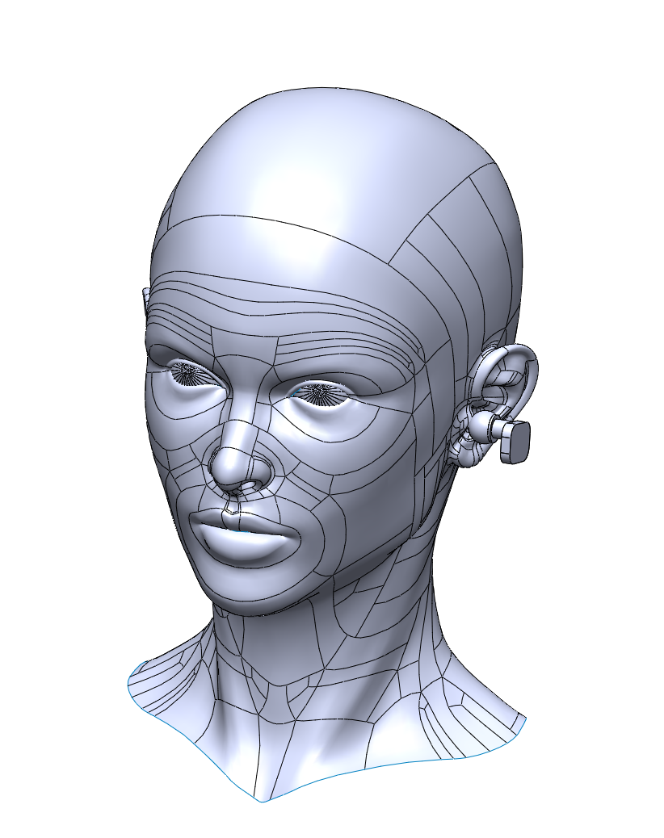
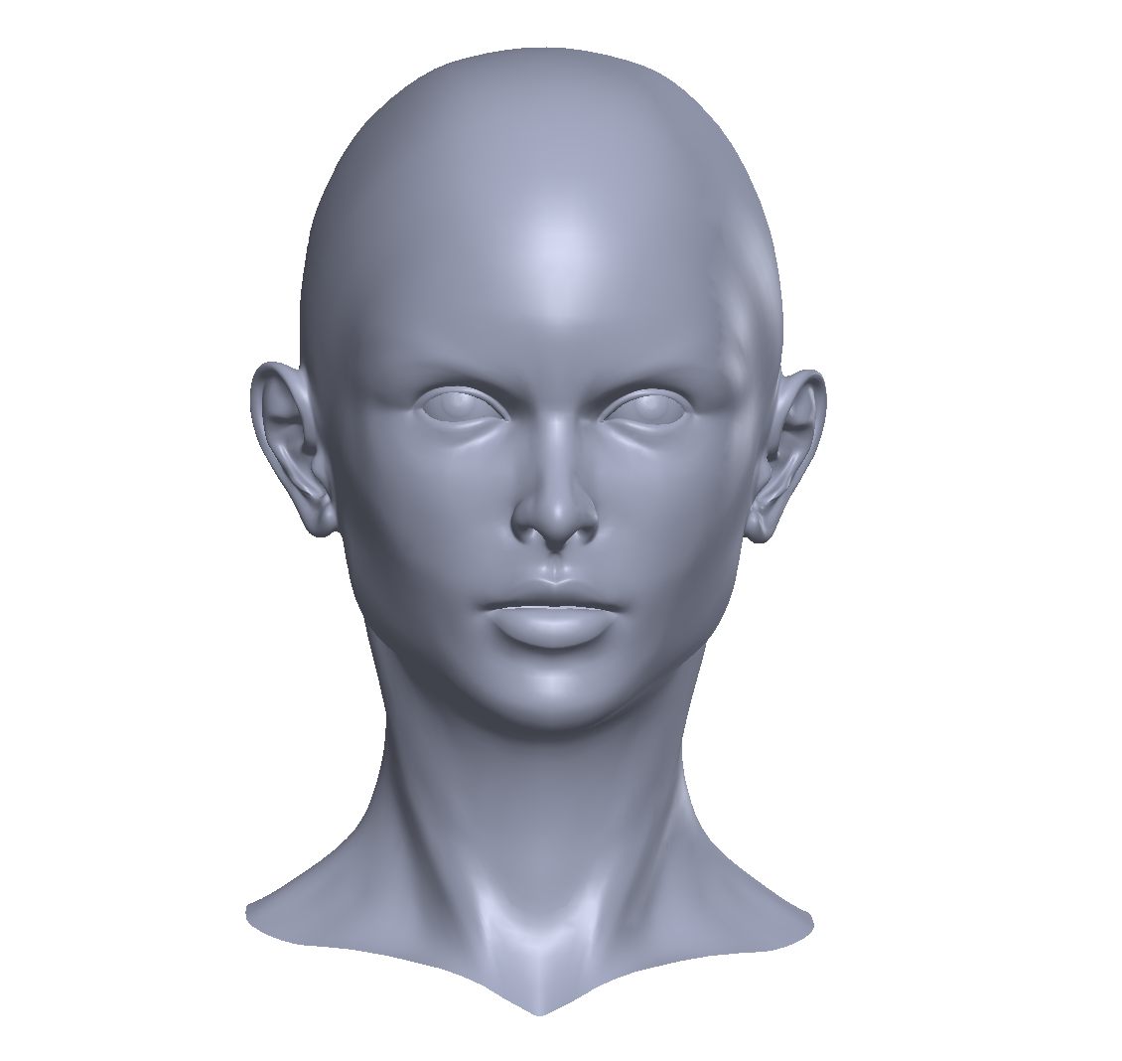
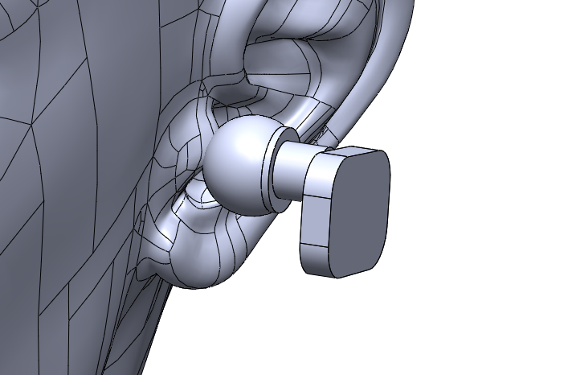
OUTPUT

Slide 11
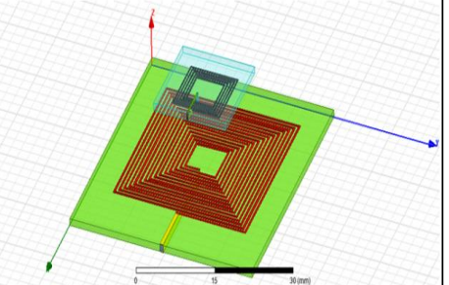
ANSYS DESIGN

Slide 12
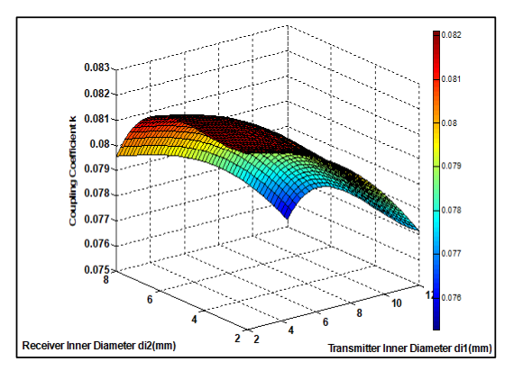
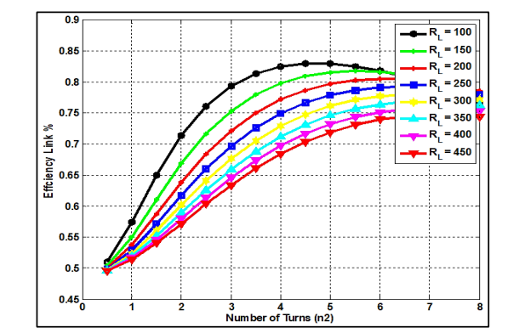
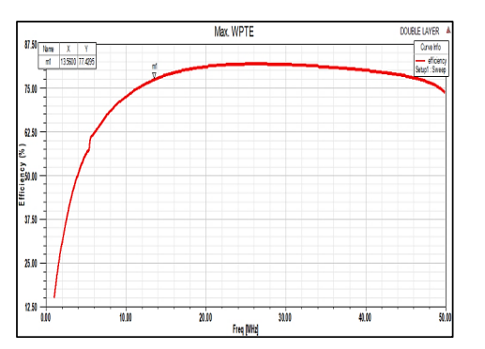
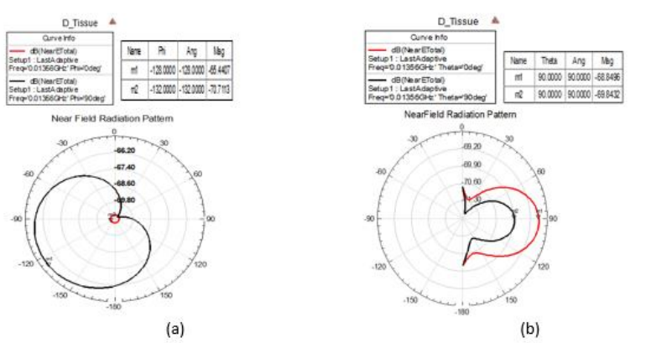

Slide 13
References :
E. Yablonovitch, Inhibited spontaneous emission in solid-state Ephysics and electronics. Phys. Rev. Lett. 58, 2059–2062.
S. John, Strong localization of photons in certain disordered dielectric superlattices. Phys. Rev. Lett. 58, 2486–2489.
M. Sigalas, E. N. Economou, Band structure of elastic waves in two dimensional systems. Solid State Commun. 86, 141–143.

Slide 14


